Slide 1

Introduction to AI(AI101B) Healthcare Data Exploration Session 2024-25 Even Semester
Team Leader: Prabhav Kansal and (University Roll no.) : 202410116100143
Member Name: Priyanshu Kansal and (University Roll no.) : 202410116100155
Member Name: Sagar Gupta and (University Roll no.) : 202410116100174
Project Supervisor : Ms. Komal Salgotra
(Assistant Professor)

Slide 2
Content
Introduction
Methodology
Code
Screenshots Output

Slide 3
Introduction
Healthcare data analysis involves exploring medical data to gain insights that improve patient outcomes, enhance hospital operations, and advance medical research. By leveraging statistical modeling, machine learning, and big data analytics, healthcare professionals and data scientists can identify trends, detect anomalies, and support evidence-based decision-making.
One of the most crucial applications of healthcare data analysis is disease prediction. By analyzing historical patient data, algorithms can forecast the likelihood of diseases, allowing for early intervention and better treatment planning.

Slide 4
Beyond patient care, data analysis plays a key role in drug discovery and healthcare policy planning. Researchers use large datasets to identify potential drug candidates, track the effectiveness of treatments, and accelerate medical advancements. Similarly, policymakers rely on data to allocate resources effectively and design healthcare programs that meet public health needs.
In this exploration, we will examine fundamental datasets, analytical methods, and software tools used in healthcare data analysis. By ensuring that insights are properly derived and applied, we can contribute to more effective and efficient healthcare solutions.

Slide 5
Methodology
Data Collection : The first step in healthcare data exploration is gathering data from diverse sources to ensure comprehensive analysis.
Electronic Health Record : Patient history, diagnoses, medications, and treatment plans.
Clinical Trials : Drug efficacy, patient responses, and treatment outcomes.
Public Health Databases : Data from organizations like the CDC, WHO, and government health portals.
Data Preprocessing and Cleaning : Raw healthcare data often contains inconsistencies, requiring preprocessing steps such as:
Handling Missing Values : Imputation techniques (mean, median, or predictive imputation) or removing incomplete records.
Removing Duplicates : Ensuring data integrity and avoiding bias.
Standard Method Terminologies : Using ICD-10, SNOMED CT, LOINC for consistency.

Slide 6
Methodology
Exploratory Data Analysis(EDA) : EDA helps in understanding data distributions, relationships, and anomalies through:
Descriptive Statistics : Mean, median, variance, and standard deviation.
Data Visualization Techniques : Histograms for distribution analysis, Scatter Plots for identifying correlations.
Pattern Identifications : Examining patient demographics, disease prevalence, and treatment efficacy.
Data Modeling and Analysis : Selecting appropriate statistical and machine learning models based on the healthcare problem
Regression Models (Linear, Logistic) : Predicting patient outcomes and disease progression.
Clustering (K-Means, DBSCAN) : Grouping patients based on disease similarity

Slide 7
Code Typed
import pandas as pd
import numpy as np
import matplotlib.pyplot as plt
import seaborn as sns
# Load the dataset
df = pd.read_csv('/content/healthcare_data (1).csv')
# Display the first few rows of the dataset
print(df.head())
# Get basic information about the dataset
print(df.info())

Slide 8
Code Typed
# Get summary statistics
print(df.describe())
# Check for missing values
print(df.isnull().sum())
# Fill missing values with the mean (for numerical columns)
df.fillna(df.mean(), inplace=True)
# Drop rows with missing values (if necessary)
# df.dropna(inplace=True)
# Set the aesthetic style of the plots
sns.set(style="whitegrid")

Slide 9
Code Typed
# Example: Distribution of Age
plt.figure(figsize=(10, 6))
sns.histplot(df['Age'], bins=30, kde=True)
plt.title('Distribution of Age')
plt.xlabel('Age')
plt.ylabel('Frequency')
plt.show()
# Example: Correlation Heatmap
plt.figure(figsize=(12, 8))
sns.heatmap(df.corr(), annot=True, cmap='coolwarm')
plt.title('Correlation Heatmap')
plt.show()

Slide 10
Code Typed
# Example: Count of Gender
plt.figure(figsize=(8, 6))
sns.countplot(x='PatientID', data=df)
plt.title('Count of Gender')
plt.xlabel('PatientID')
plt.ylabel('Count')
plt.show()
# Example: Boxplot of Cholesterol by Gender
plt.figure(figsize=(10, 6))
sns.boxplot(x='PatientID', y='SugarLevel', data=df)
plt.title('SugrLevel By Patient ID')
plt.xlabel('PatientID')
plt.ylabel('SugarLevel')
plt.show()

Slide 11
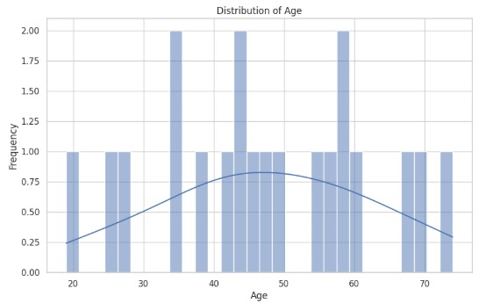
Screenshots Output

Slide 12
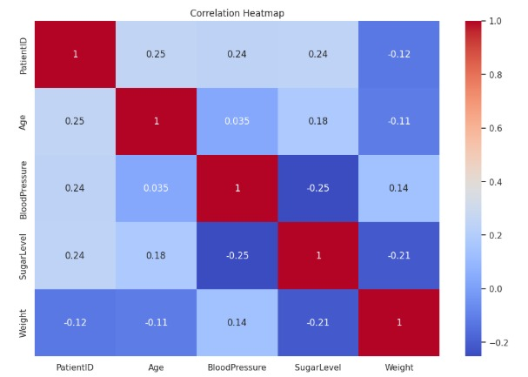
Screenshots Output

Slide 13
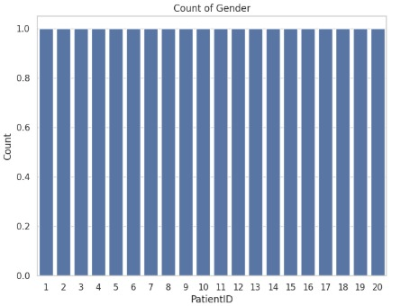
Screenshots Output

Slide 14
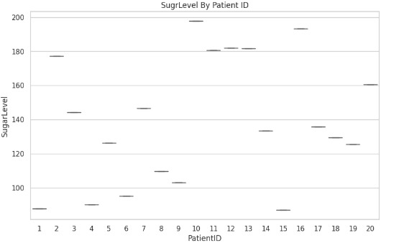
Screenshots Output

Slide 15
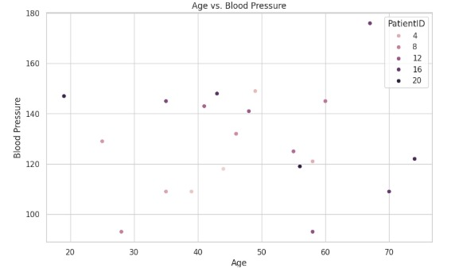
Screenshots Output

